Slide 1
NASA SPACE
APPS CHALLENGE
S.E.A.A.S (Space Expansion and Automated Assembly System)
Perpetual Motion Squad

Slide 2
S.E.A.A.S
INTRODUCTION:
- Manufacturing of components and research facilities in space has been a complicated process requiring
the need for astronauts to schedule a space walk in order to monitor the process and also consumes a lot of resources and time to complete the process.
- Docking process requires manual operation or more advanced systems that requires maintenance and also increased capital for construction.
- Also in order to increase the space required to install another research facility the existing facility or room space cannot be increased or extended. Instead a separate facility is manufactured and then the main facility is modified to accommodate the new space by docking.
- The aim of our concept is to simplify these processes and improving the process of assembling components in space.

Slide 3
S.E.A.a.S
OBJECTIVE:
- We aim to make use of a simpler method to expand the space available for research and other activities in the ISS(currently) and other facilities that would become available under microgravity conditions in the near future.
- Through this particular method of space expansion the need for human power and modification of the facility is less to null.
- Also, reducing the need for frequent space walks for maintenance, modification activities and other routine repetitive tasks can be reduced by deploying a semi- automated entity in the form of a robot.

Slide 4
S.E.A.a.S
WORKING OF Space Expansion System:
- The unit is similar to the current system in the ISS which is cylindrical and is docked to the ISS on one end. The difference here is that this structure longitudinally has one half of it rigid and the other half flexible and locked in a manner similar to the hose band clamp.
- The clamp is held together by solenoidal actuation units that lock it in place.
- The clamp also has a slot for the expansion unit to be attached.
- Once the expansion unit arrives through propulsion and automated guidance systems it navigates towards the unit by knowing it coordinates with respect to the main facility after entering a reasonable region of proximity.
- The expansion unit after reaching the unit aligns itself to insert the slot into the unit’s slot to synchronize themselves and then locks itself to the unit. Later the unit makes sure that proper pressure conditions are present in the expansion unit and then releases the solenoidal valves.
- Since one half of the units have flexibility, they open up to create a larger combined space of the two units. The expansion can be achieved by placing actuators along the flexible region which straightens by reducing its curvature through actuation.

Slide 5
S.E.A.a.S
WORKING OF Automated Assembly system:
- The semi-autonomous robot can be deployed near the facility and it would maintain proximal distance with the facility and performs monitoring activities periodically and goes into hibernation while no task is given.
- It can be operated remotely from the facility to perform various tasks that are come under the category of repetitive and dangerous tasks.
- During missions that involve assembly of launched modules from earth it can be switched to perform autonomously and assemble the module to the main facility starting with the change of end effector to be used.
- The robot has tools/ end effectors required to perform various tasks and it can switch to these tools from the main facility where the tools are place on the outside and while in need of change of tool, the robot can move to this region and change the tools by replacing it.
- It uses cold gas thrusters placed in various locations on its body to orient itself and navigate through space around the facility and uses solar energy to operate and charges itself during hibernation periods.

Slide 6
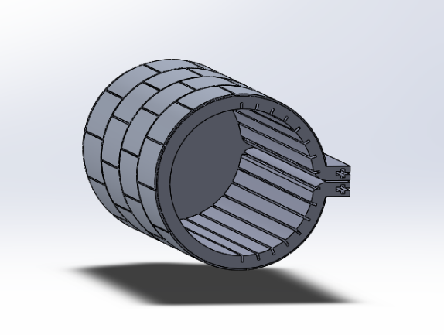
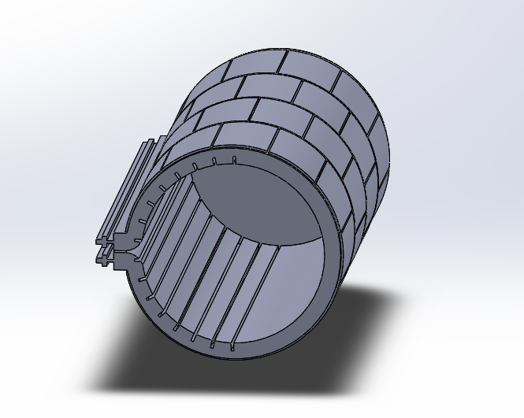
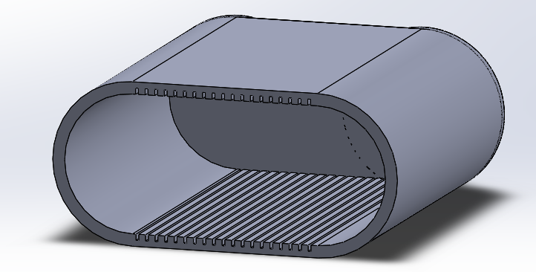
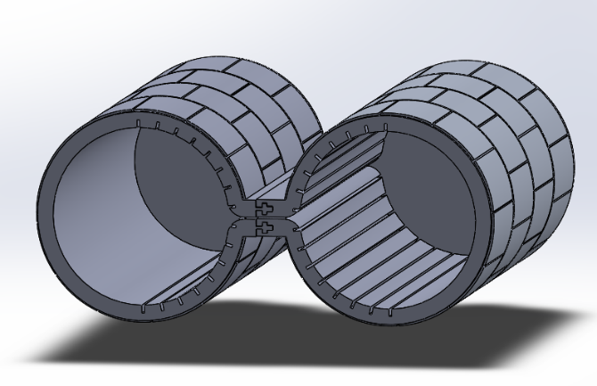
S.E.A.a.S
CAD Models of the Capsules and the process:

Slide 7
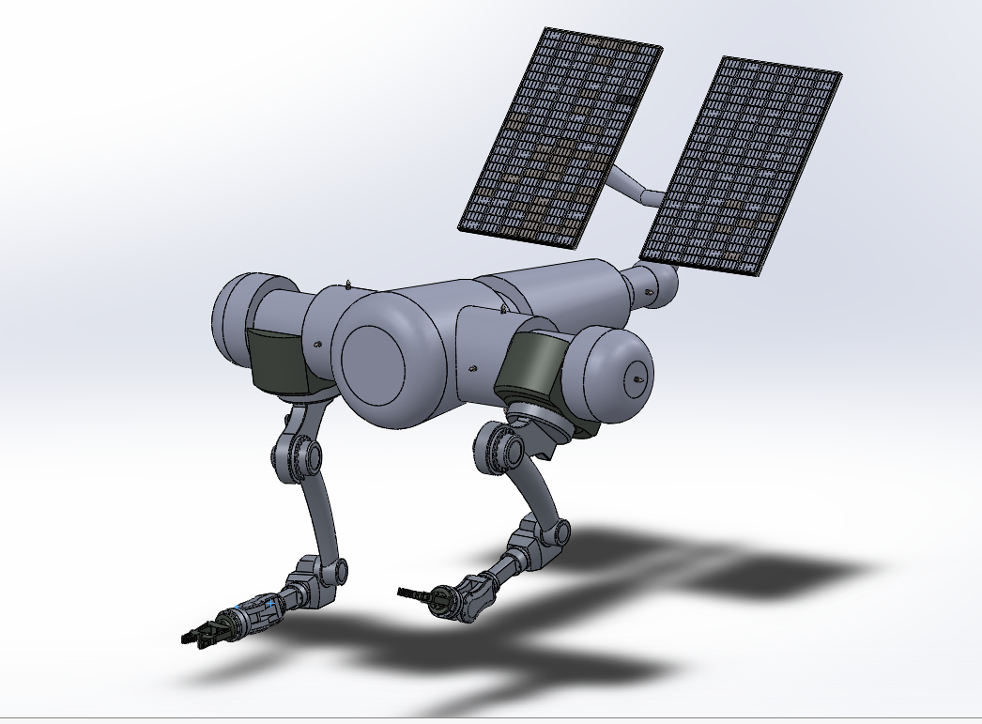
S.E.A.a.S
3D Model of Automated Assembly system:
The model here has movable robotic arms along with the solar panels that orient themselves towards the direction of sun

Slide 8
Thank You

